Slide 1
PROJECT REPORT
BY VICTOR AGBOLI IFECHUKWUDE

Slide 2
AGENDA
PROBLEM STATEMENT
ANALYSIS AND INFERENCE
RECOMMENDATONS

Slide 3
PROBLEM STATEMENT
The dataset given contained information about employees who stayed and left in a company.
We are required to answer these questions:
What type of employees are leaving?
Which employees are prone to leave next

Slide 4
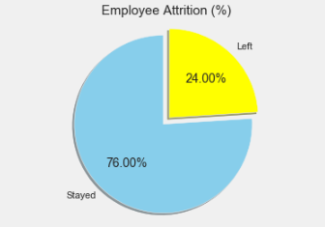

ANALYSIS AND INFERENCE
From the Pie chart, we can see that:
The percentage of employees who stayed is
76%, and the percentage of employees
who left is 24%. This percentage is large
enough to cause concern for the company.
The satisfaction level of employees who
stayed is 0.67 which is higher than the
satisfaction level of 0.44 of employees
who left .

Slide 5
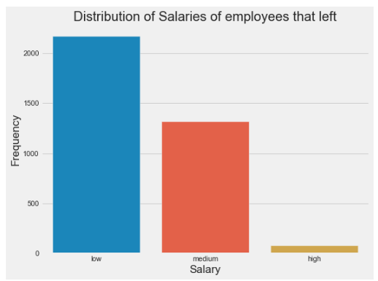
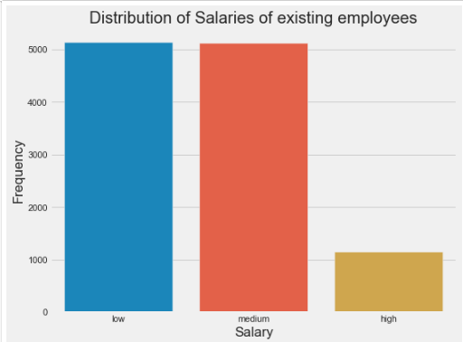
ANALYSIS AND INFERENCE
From the bar plots, these inferences can
be drawn:
The employees who left earned a little less in
the “medium” and “high” category
The employees who stayed earned more in
the “medium” and “high” category
Conclusion: employees who left were earning
less than those who stayed.
They were underappreciated.

Slide 6
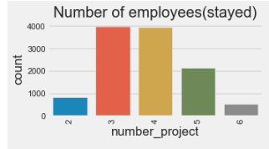
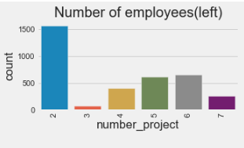
ANALYSIS AND INFERENCE
From the bar plots, these inferences can
be drawn:
The employees who left worked on less or too
much projects
The employees who stayed mostly did 3-5
projects
Conclusion: employees who left were being under
And overworked. In other words, their ability wasn’t
optimised.

Slide 7
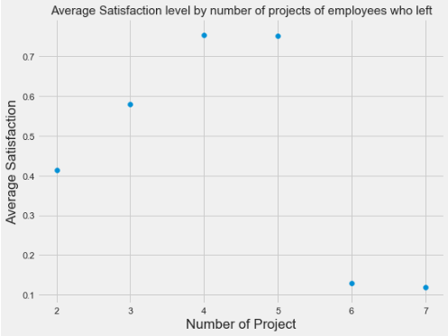
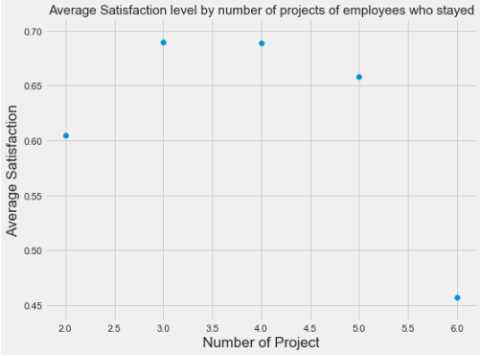
ANALYSIS AND INFERENCE
From the scatter plots, these inferences
can be drawn:
The employees who left had a higher level of
satisfaction when they did 4- 5 projects,
and lower level of satisfaction when they did
any project higher or lower than that.
The employees that stayed had a higher level of
satisfaction when they did 3-5 projects, and low
level of satisfaction when they did any project
higher or lower than that.
Conclusion: for better employee satisfaction, the
number of projects should be between 3-5.

Slide 8
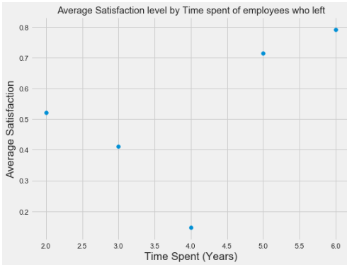
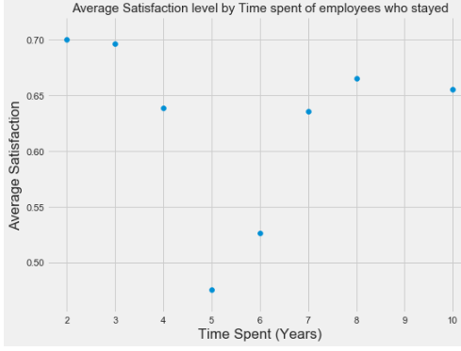
ANALYSIS AND INFERENCE
From the scatter plots, these inferences
can be drawn:
The employees who left had steady decline in the
level of satisfaction from 2-4 years, and rose
significantly from 5-6 years.
The employees that stayed had steady decline in
the level of satisfaction from 2-5 years, and rose
significantly from 7-10 years
Conclusion: those employees prone to leave the
Company are those that have spent between
3-5 years

Slide 9
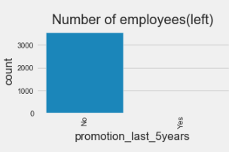
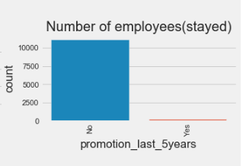
ANALYSIS AND INFERENCE
From the bar plots, these inferences
can be drawn:
The employees who left had not received any
promotion in the last 5 years.
The employees that stayed had received
promotion in the last 5 years.
Conclusion: those employees prone to leave the
Company are those that have not received promotion
In the last 5 years.

Slide 10
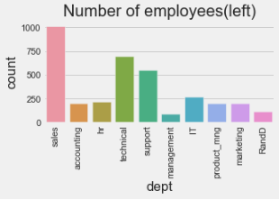
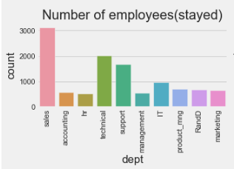
ANALYSIS AND INFERENCE
From the bar plots, these inferences
can be drawn:
Most of the employees who left came from
sales, technical and support departments
Most of the employees that stayed came from
the sales, technical and support departments
Conclusion: special attention should be given to these
departments; sales, technical and support
Departments i.e. people whose functions
has to do with dealing with clients or customers

Slide 11
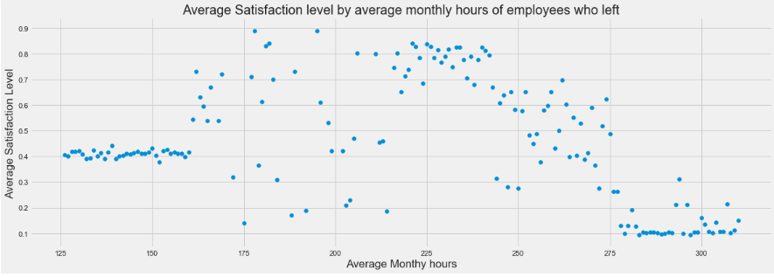
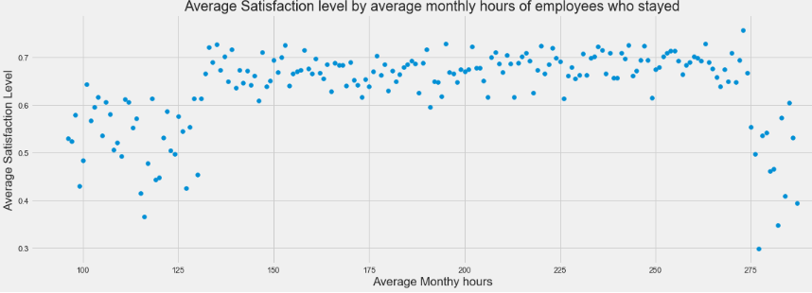
ANALYSIS AND INFERENCE
From the scatter plots, these inferences
can be drawn:
For the employees who left, they had high
satisfaction level when the average
monthly hours was between
175 -225 hours. Anything else gives a low
satisfaction level
For the employees who stayed, they had high
satisfaction level when the average
monthly hours was between
130 -275 hours. Anything else gives a low
satisfaction level
Conclusion: for best satisfaction level, employees
shouldn’t work less or more than 175 – 225
hours on an average per month

Slide 12
INFERENCE
What type of employees are leaving?
Those who weren’t promoted in the last 5 years
Those whose are low to medium salary earners
Those who belonged to a department whose functions had to do with dealing with clients
Those who did too little or too much projects
Those who had spent between 2-4 years in the company
Those whose average monthly hours is below or above 175 - 225 hours

Slide 13
INFERENCE
Which employees are prone to leaving?
Those who weren’t promoted in the last 5 years
Those whose are low to medium salary earners
Those who belonged to a department whose functions had to do with dealing with clients
Those who are doing less or more than 3-5 projects
Those who had spent between 3-5 years in the company
Those whose average monthly hours is below or above 130 - 275 hours

Slide 14
RECOMMENDATIONS
Employees should be given 3-5 projects to avoid decrease in satisfaction level.
Faster promotions needs to be given to deserving employees.
The average monthly hours for the employees should be between 130-275 hours to avoid under and over utilization.
Better incentives and salary structures needs to be implemented to avoid decrease in satisfaction level.
Retraining and incentives should be given to employees whose function has to do with dealing with clients.
The company values and culture needs to be stated every now and then, so employees can have long term career plans in the company.

Slide 15
THANK YOU
CONTACT DETAILS
Name: Victor Agboli Ifechukwude
linkedIn: https://www.linkedin.com/in/victoragboli/
Email: victoragboli@gmail.com

